Slide 1




Digital Portfolio
_{STUDENT NAME:} Hari prathap.s
REGISTERNO AND NMID:
asunm1439222407209
_{DEPARTMENT:} BSC.COMPUTERSCIENCE
COLLEGE: COLLEGE/ UNIVERSITYMADRAS UNIVERSITY

Slide 2



PROJECT TITLE
“Interactive Digital Portfolio – A Web-Based Showcase of Skills and Achievements”

Slide 3



AGENDA
Problem Statement
Project Overview
End Users
Tools and Technologies
Portfolio designandLayout
Features and Functionality
Results and Screenshots
Conclusion
Github Link
3/21/2024 AnnualReview

Slide 4


PROBLEM STATEMENT
Students often lack a single, well-organized place to present their skills, certificates, and resume.A digital portfolio solves this by combining everything in a professional, accessible website.

Slide 5

PROJECT OVERVIEW
This project is a personal portfolio website that displays my profile, skills, certificates, and resume with an attractive design and smooth animations.

Slide 6
WHO ARE THE END USERS?
Recruiters, HR teams, faculty evaluators, classmates, and anyone interested in viewing my academic and technical achievements.

Slide 7


TOOLS AND TECHNIQUES
HTML5, CSS3, JavaScript, Particles.js, Canvas animations, and LocalStorage for theme memory.(It can be deployed on GitHub Pages or Netlify.)

Slide 8


POTFOLIO DESIGN AND LAYOUT
A single-page layout with an animated gradient background, starfield effect, light/dark themes, and rounded cards for each section.

Slide 9
FEATURES AND FUNCTIONALITY
Theme switcher, smooth scroll navigation, responsive design, certificates gallery, resume preview & download, and background animations.

Slide 10
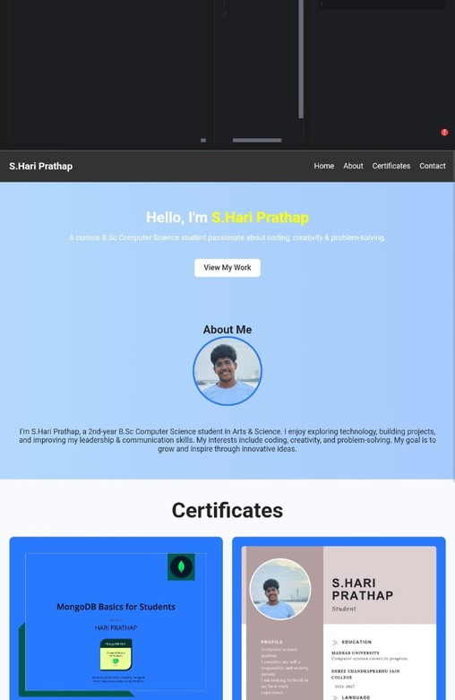

RESULTS AND SCREENSHOTS
The site successfully showcases my profile with a clean interface, interactive effects, and clear access to certificates and resume.
3/21/2024 AnnualReview
10

Slide 11
CONCLUSION
The Digital Portfolio is an effective way to present my skills and achievements online, reflecting both my technical ability and creative approach.
11

